Slide 1


Vector Database Introduction
#nocodefarm

Slide 2
Agenda
What is vector databases
What are the use-cases where it's used
What are some examples of Vector DB
Why they have become popular recently
One real life example to explain

Slide 3
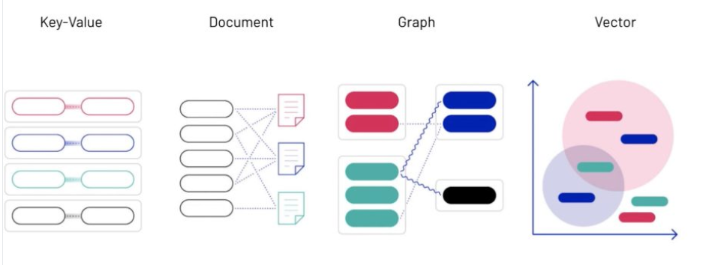
What is vector database?
A vector database is a specialized database designed for efficiently storing and querying vector data.
In this context, a vector represents information in a multi-dimensional space, often used to denote relationships and similarities between data points.

Slide 4
Use Cases of Vector Databases
Machine Learning: Vector databases are crucial for storing embeddings in machine learning tasks like natural language processing, where words or documents are represented as vectors.
Geospatial Analysis: In applications involving maps and geographic data, vector databases are used to store spatial information efficiently.
Recommendation Systems: They play a role in recommendation engines by storing and querying vectors that represent user preferences and item features.

Slide 5
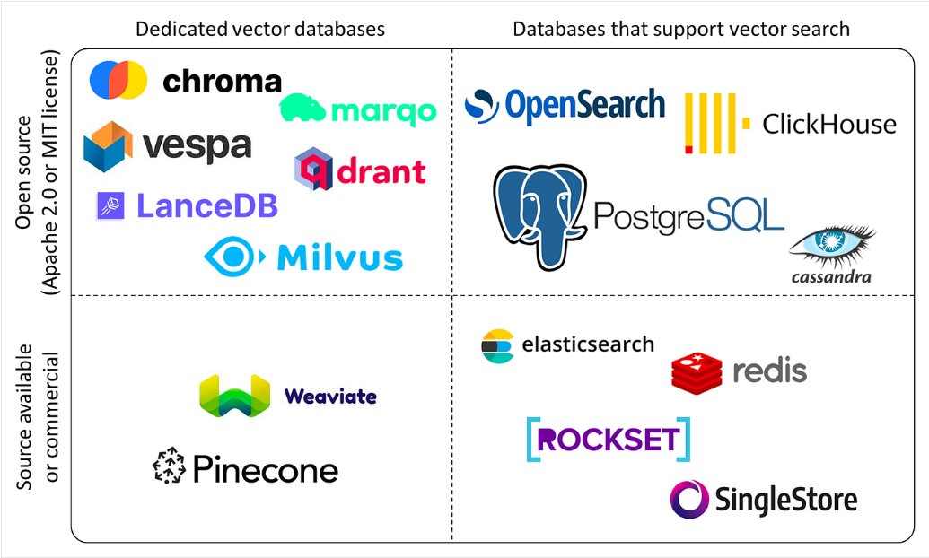
Examples of Vector Databases
Pinecone: It is a managed vector database platform that has been purpose-built to tackle the unique challenges associated with high-dimensional data.
Milvus: An open-source vector database designed for similarity search and analytics tasks, often used in applications like image and video search.

Slide 6
Popularity Reasons
Advancements in AI and ML: With the rise of machine learning and artificial intelligence, there's an increased need for efficient storage and retrieval of vector data.
Growing Applications: As use cases like recommendation systems and geospatial analysis become more prevalent, the demand for specialized vector databases has surged.

Slide 7
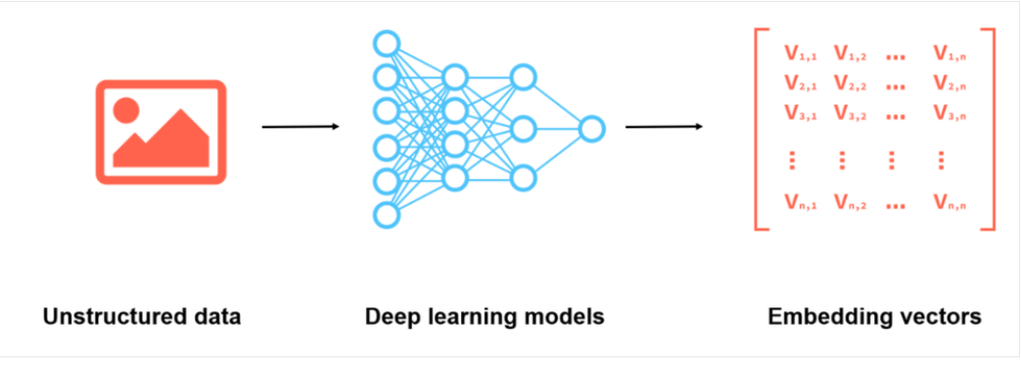
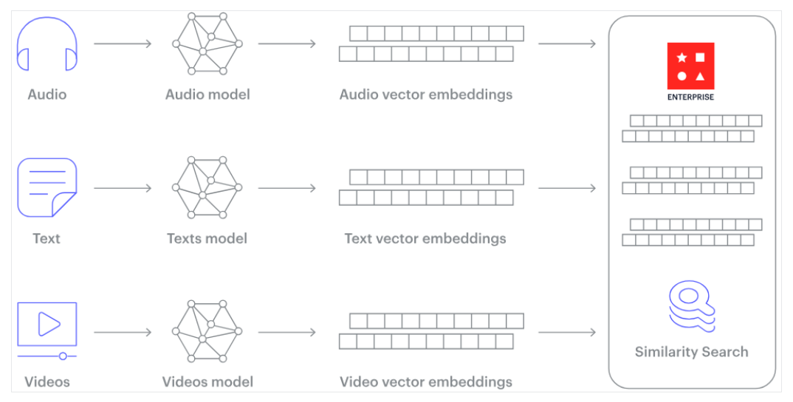
How Does a Vector Database Work?

Slide 8
Real-life Example
Let's consider a recommendation system for movies.
Each movie is represented as a vector in a high-dimensional space based on various features like genre, actors, and viewer ratings.
Vector Storage: The vectors for all movies are stored in a vector database.
Use Case: When a user expresses preferences, their preferences are converted into a vector. The vector database then efficiently retrieves movies with similar vectors, recommending those with features akin to the user's preferences.
Example Database: A system like Milvus or Faiss facilitates quick and accurate retrieval of movie vectors.

Slide 9
Few followups..

Slide 10
Vector

Slide 11
Vector??
In mathematics and physics, a vector is a mathematical entity that represents a quantity with both magnitude and direction.
It is often used to describe physical quantities such as displacement, velocity, force, or any other measurable quantity that has both size and direction.
In computer science and data science, the concept of vectors is extended to represent data points in a multi-dimensional space.
For example, in machine learning, word embeddings or image features are often represented as vectors, enabling mathematical operations and comparisons.
Understanding vectors is fundamental in many areas of mathematics, physics, and computer science, and their versatile nature makes them a powerful tool for representing and analyzing various types of data.

Slide 12
Characteristics of vectors?
Magnitude: It represents its size or length and is denoted by a non-negative scalar. In physical terms, it could represent the amount or quantity of something.
Direction: Vectors have a specific direction in space. This indicates the orientation or the way in which the vector is pointing. It could be specified using angles or with respect to a coordinate system.
Representation: Vectors are commonly represented using ordered sets of numbers, often in a column or row format. In three-dimensional space, a vector might be represented as (x,y,z)
Notation: Vectors are often denoted by boldface letters (like v) or with an arrow symbol over the variable (like → v)
Operations: Vectors support various mathematical operations, such as addition, scalar multiplication, dot product, and cross product. These operations allow for manipulation and analysis of vector quantities.

Slide 13
Vector Data

Slide 14
What is Vector Data??
Vector data refers to information that is represented as vectors, which are mathematical entities used to depict quantities with both magnitude and direction.
In the context of databases and computing, vector data often represents points or entities in a multi-dimensional space.

Slide 15
Characteristics of vector data?
Multidimensional Representation: Vectors have multiple dimensions, each corresponding to a different feature or attribute. For example, in a 3D vector (x, y,z) , each dimension represents a spatial coordinate.
Magnitude and Direction: Vectors have both magnitude (length) and direction. The values in each dimension contribute to the overall characteristics of the vector.
Application in Data Representation: In various fields, data such as text, images, or numerical features can be represented as vectors. For instance, in natural language processing, words or documents can be embedded into high-dimensional vectors, capturing semantic relationships.
Similarity and Distance Metrics: Vector data allows for the calculation of similarity or distance between vectors. This is crucial in tasks like nearest neighbor search or recommendation systems, where finding similar vectors is a common operation.

Slide 16
Example
if you represent colors in an image using RGB values, each pixel's color can be a vector (R, G, B).
In machine learning, documents can be represented as vectors in a space where words are dimensions, capturing the semantic meaning of the text.
Vector data is versatile and finds applications in a wide range of fields, from computer vision to natural language processing.

Slide 17
Graph vs Vector

Slide 18
Representation
Vector Data: Represents information in a multi-dimensional space using vectors. Each dimension corresponds to a specific feature or attribute. Vectors can be used to represent various types of data, such as numerical features, text embeddings, or spatial coordinates.
Graph Data: Represents relationships between entities using nodes and edges in a graph structure. Nodes typically represent entities, and edges represent connections or relationships between those entities.

Slide 19
Structure
Vector Data: Organized as vectors in a multi-dimensional space. The structure is typically flat, with no explicit connections between individual vectors.
Graph Data: Organized as a graph, with nodes and edges forming a network. The structure explicitly defines relationships between entities through connections.

Slide 20
Use Cases
Vector Data: Commonly used in tasks like machine learning, similarity search, and numerical analysis. Applications include natural language processing, image processing, and recommendation systems.
Graph Data: Ideal for modeling and analyzing relationships, connections, and dependencies. Applications include social networks, knowledge graphs, and network analysis.

Slide 21
Operations
Vector Data: Operations involve vector manipulation, such as calculating distances, finding nearest neighbors, or performing mathematical operations on vectors.
Graph Data: Operations involve traversing the graph, identifying patterns, finding paths, and analyzing the structure of the network.

Slide 22
Final thoughts
While there can be overlap in certain applications, especially when dealing with data that can be represented both as vectors and graphs.
The fundamental difference lies in the representation and organizational structure.
Vector data focuses on numerical representations in a multi-dimensional space, while graph data emphasizes the relationships between entities in a network structure.

Slide 23
More examples ..
Head to chat-gpt
https://chat.openai.com/share/15d6324a-3717-49e6-bf1a-1d71684dc731

Slide 24
More to explore
https://www.datacamp.com/blog/the-top-5-vector-databases

